Slide 1

Data project 1: EDA & DATA CLEANING
Team Members: Manjot Kaur, Waryam Kaur, ArpandeepKaur, Manoj Bhatta
Course Name: CMPT 2400
Instructor Name: Nasimeh Asgarian

Slide 2

INTRODUCTION
Data Cleaning and Analysis for Predicting Emissions in a Post-Coal Scenario
Objective: Estimate pollutant releases from the fossil fuel electricity generation sector after coal plants are phased out by 2030.
Dataset Used: NPRI dataset filtered for fossil fuel electricity generation.
Methods Applied:
Data cleaning (handling missing values, outliers, inconsistencies).
Data visualization.
Basic exploratory analysis for emissions patterns.

Slide 3
PROBLEM STATEMENT:
Why This Matters?
Coal-fired power plants are the largest contributors to SO₂, NOx, and CO₂ emissions.
Canada is committed to eliminating coal power by 2030.
The shift will impact pollution levels, health, and regulatory policies.
Key Research Question:
How will emissions change after coal plants shut down?
What patterns do we observe in current emissions?
What will be the expected emissions from remaining fossil fuel plants?

Slide 4


Dataset OVERVIEW Data Source: NPRI dataset (filtered for electricity generation).
Key Columns:
Company_Name, Facility_Name, NAICS_Code: Identifies industries.
PROVINCE: Location of pollution release.
CAS_Number, Substance_Name: Chemical substances involved.
Comment_Type_Name: Type of data provided.
Comment: Description of changes or observations.

Slide 5
KEY CHALLENGES IDENTIFIED
Missing Data: Gaps in pollutant release records.
Outliers: Extreme emission values.
Categorical & Numerical Imbalances: Some feature inconsistencies.
Duplicate Rows

Slide 6
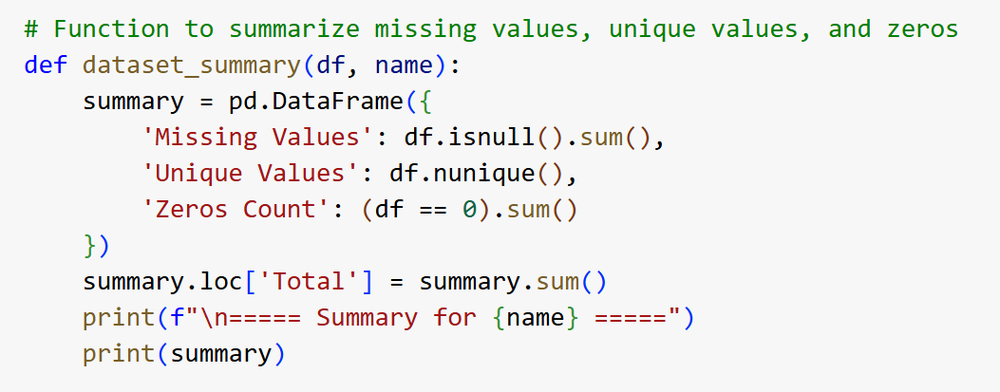
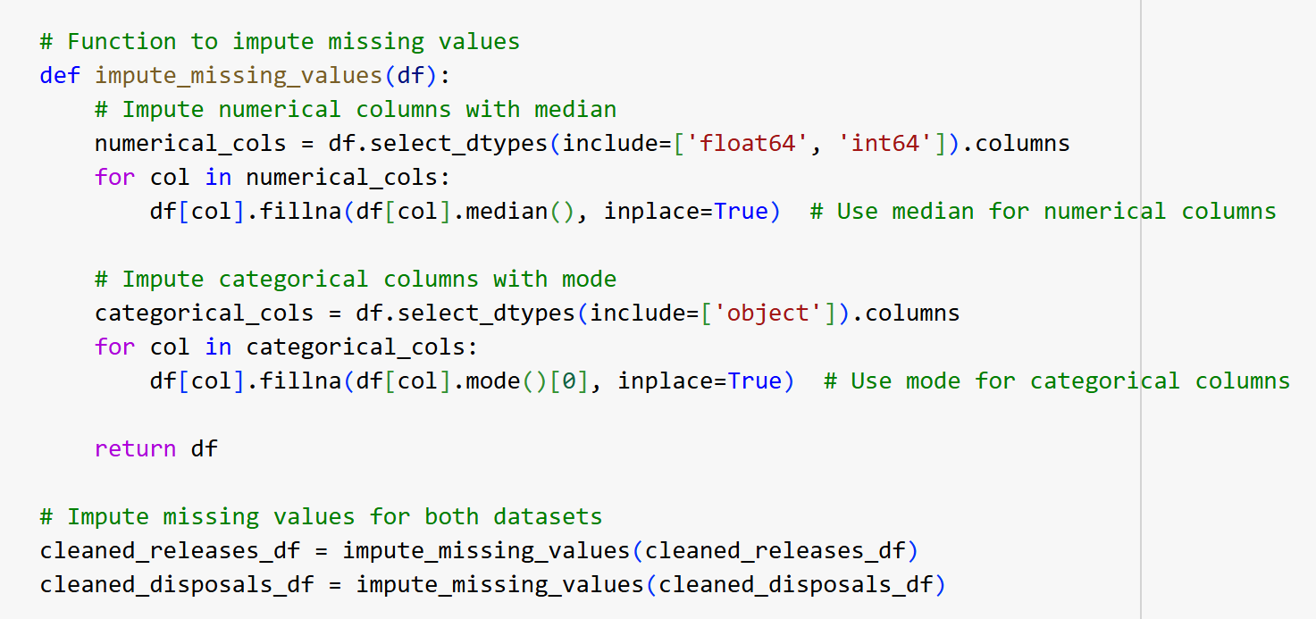
DATA CLEANING PROCESS
Handling Missing Values
Used a custom function to detect missing values.
Applied Imputation Strategies:
Numerical Values: Filled using median imputation to avoid skewing data.
Categorical Values: Replaced missing entries with the most frequent category (mode).
Why this approach?
Prevents information loss while maintaining dataset integrity.
Ensures dataset remains ML-compatible.

Slide 7
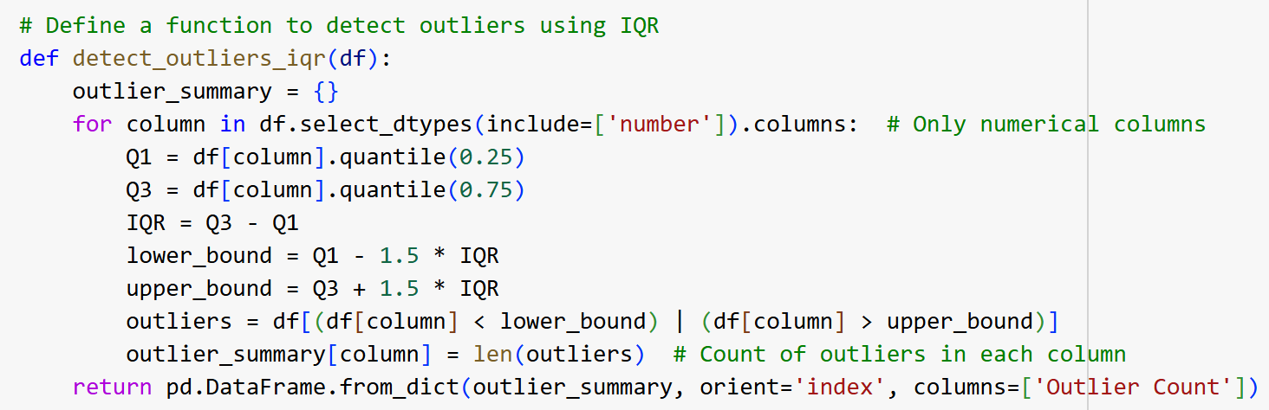
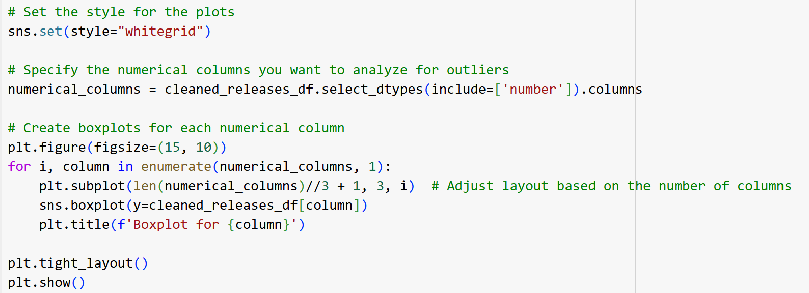
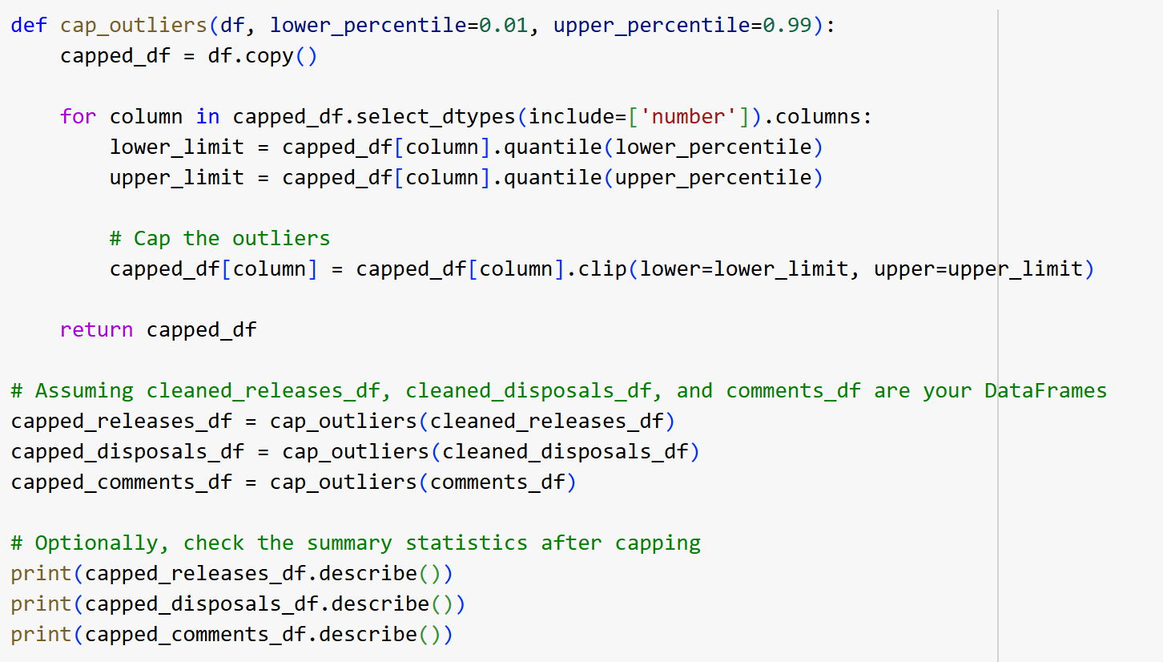
DATA CLEANING PROCESS
Outlier Detection Method Used:
Interquartile Range (IQR) Method
Boxplot Analysis
Findings:
A few facilities had abnormally high pollutant releases.
Possible reasons:
Errors in reporting, actual environmental violations.
Action Taken: Capped Outliers
Method Used: Capped outliers using 1st and 99th percentile instead of removing them. Why?
Preserves Data Integrity (No loss of useful information)
Prevents Skewed ML Models (Avoids bias from extreme values)
Maintains Realistic Industry Trends

Slide 8
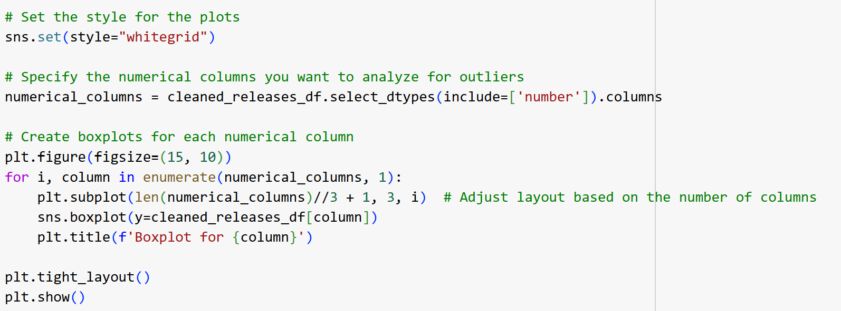
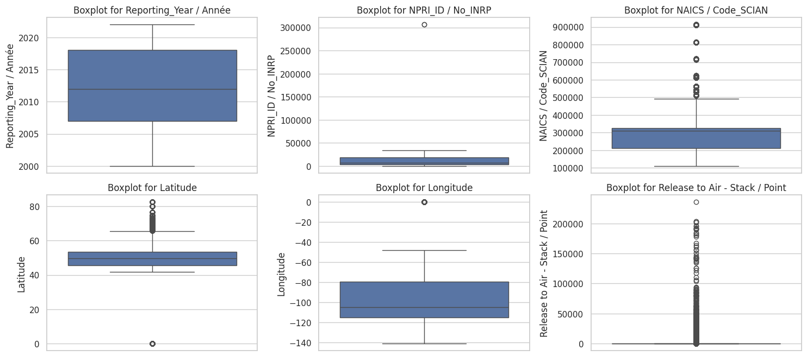
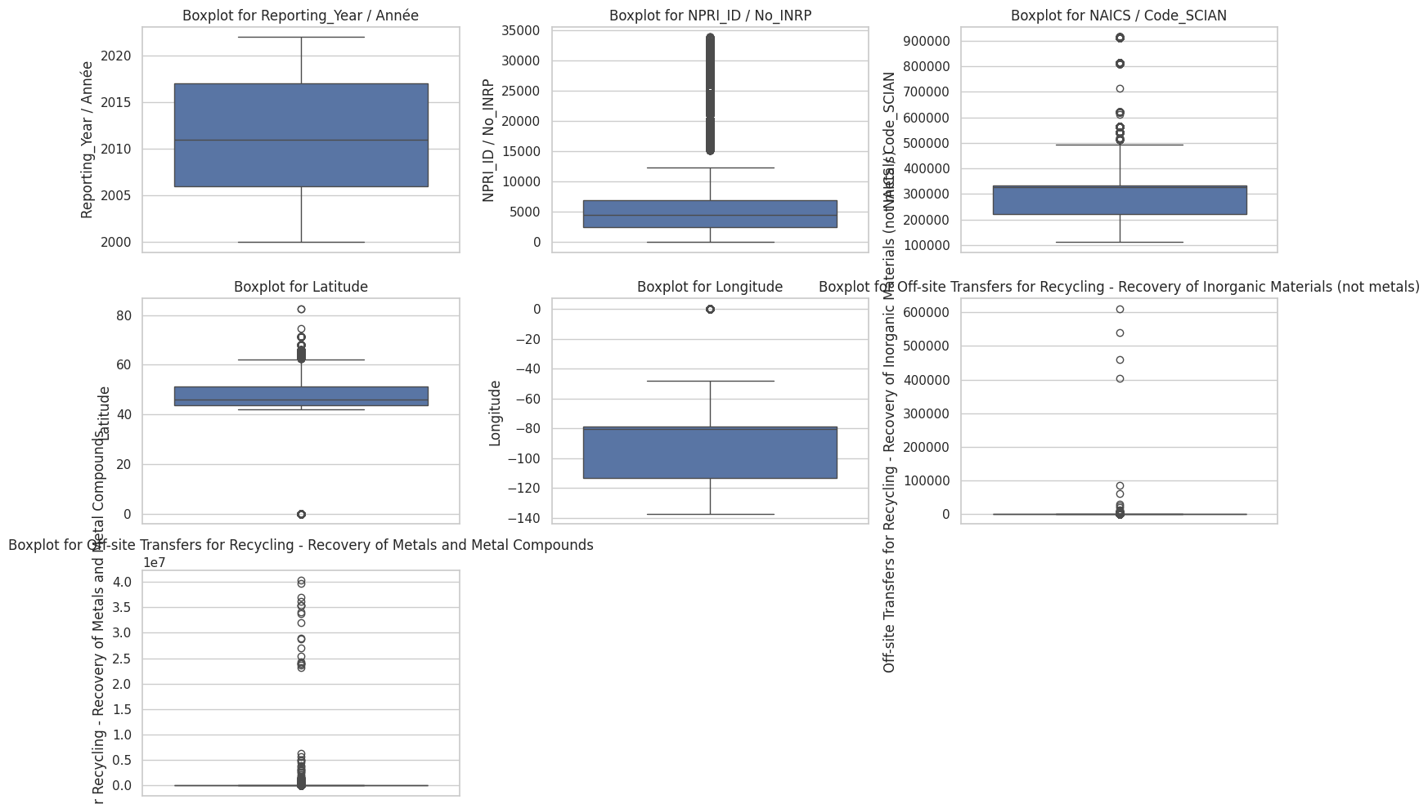
BOXPLOT ANLYSIS OF OUTLIERS

Slide 9
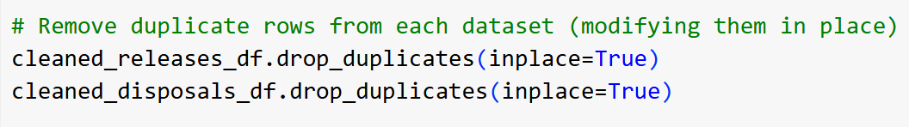
DATA Cleaning Process
Handling Duplicate Values:
Duplicates can distort analysis by over-representing certain data points.
They inflate emission counts, leading to incorrect conclusions.
Keeping only unique records improves data accuracy and reliability.
Solution: Using drop_duplicates()
The function removes repeated rows while keeping the first occurrence.
inplace=True ensures the dataset is modified directly without creating a copy.

Slide 10
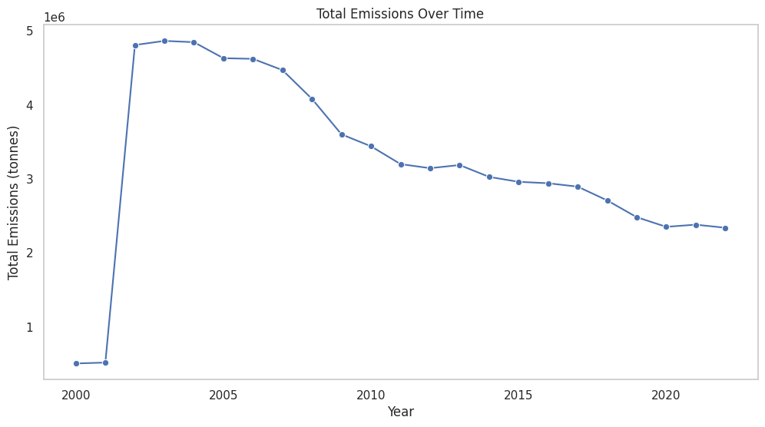
Emissions Over Time
Findings:
Peak emissions (~5M tonnes) in early 2000s.
Sharp decline post-2010 (early coal phase-out).
Steady decline since 2015, slower reduction.
Insights:
Emissions will continue dropping post-2030 if the trend persists.
SO₂ will significantly reduce, linked to coal shutdown.
CO₂ & NOx reduction depends on energy transition (gas vs. renewables).
Future Impact:
Renewables → Faster decline in emissions.
Natural gas replaces coal → CO₂ may stay high.

Slide 11
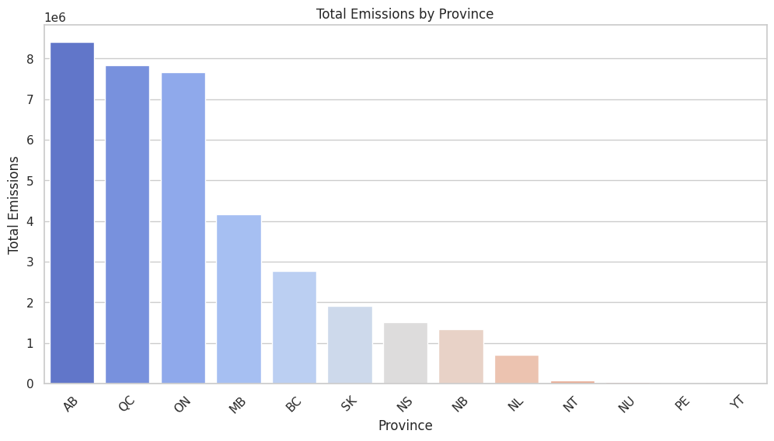
Total Emissions by Province
What the Graph Shows:
Ontario has the highest number of employees (~4M), followed by Quebec (~1.5M) and Alberta (~1M).
Smaller provinces have significantly fewer industrial employees.
Insights Related to the Problem:
Coal-heavy provinces (AB, QC, ON) will see the biggest reductions post-2030.
Alberta, as the most coal-dependent, will experience the most drastic emissions drop.
Smaller provinces will not be significantly affected by the coal phase-out.

Slide 12
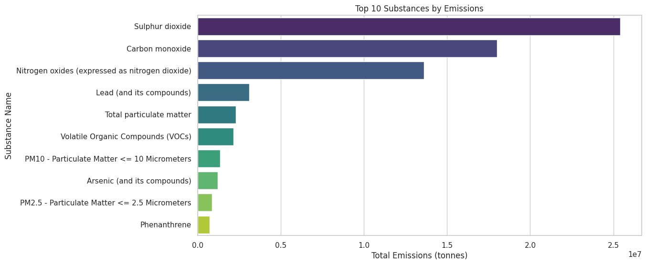
Top 10 Substances by Emissions
Findings:
SO₂ highest emission, primarily from coal.
CO & NOx also major pollutants (linked to fossil fuels).
PM10 & PM2.5 lower but still present.
Insights:
SO₂ will see the biggest reduction after 2030 since it’s primarily from coal.
NOx and CO may persist if coal is replaced with natural gas.
Air quality improvements will depend on how emissions are managed beyond coal.

Slide 13
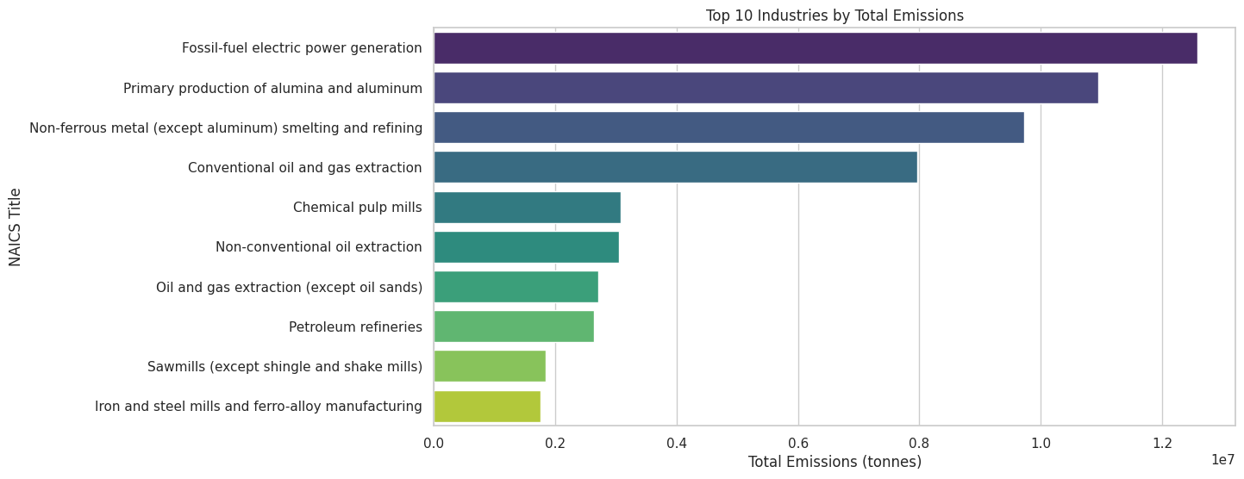
Top 10 Industries by Total Emissions
Findings:
Fossil-fuel electricity generation is the top-emitting industry.
Oil & gas extraction and metal refining are also major contributors.
Mining and aluminum production contribute significantly to pollution.
Insights:
Once coal is removed, electricity sector emissions will decline sharply.
Oil & gas may replace electricity as the top emitter post-2030.
Other industries (metal refining, mining) will continue polluting.

Slide 14
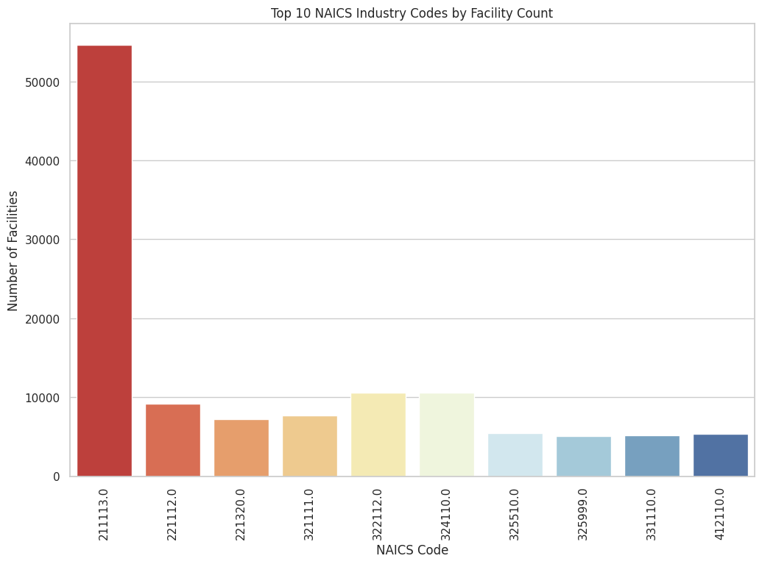
Top 10 NAICS Industry Codes by Facility Count
Findings:
Oil & gas extraction (NAICS code 211113) is the most common polluting industry.
Electricity generation (221112) is a major category.
Forestry, mining, and manufacturing also contribute.
Insights:
Oil & gas will dominate emissions after coal plants shut down.
Natural gas plants may still be a significant contributor.
Industrial emissions will remain unless stricter regulations are imposed.

Slide 15
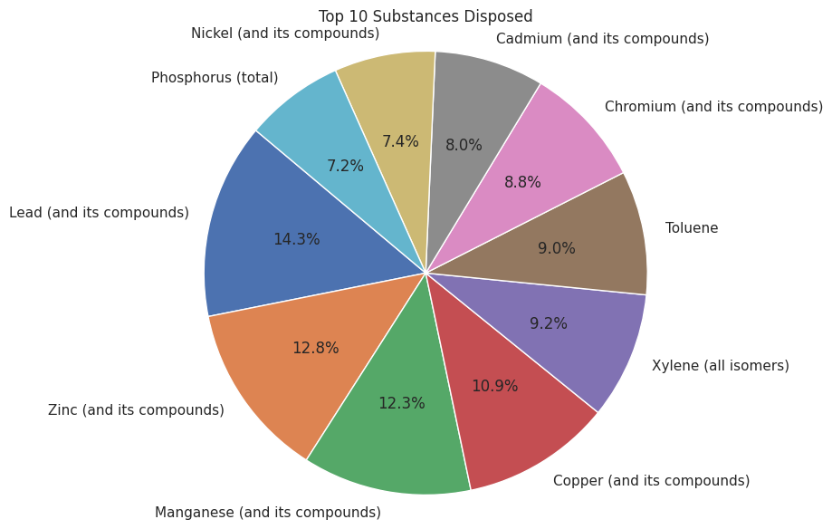
Chemical Disposal Analysis
Findings:
Lead, Zinc, Manganese dominate disposal.
Heavy metal waste is a long-term pollution issue.
Insights:
Coal phase-out reduces air pollution but doesn’t solve waste disposal issues.
Industrial waste management remains critical.
Future Impact:
Policies needed for both air emissions & industrial waste treatment.

Slide 16
SUMMARY & NEXT STEPS
Data cleaned & outliers handled for better accuracy.
Trends analyzed: Coal shutdowns already reducing emissions.
Industries & pollutants identified: SO₂, CO, NOx are key focus areas.
Next Steps:
Feature engineering for predictive models.
Building ML models for pollution forecasting.

Slide 17
THANK YOU

